Slide 1

Car Market Analysis
AICTE STU ID : STU662f4bad170001714375597
PINKI

Slide 2

PROBLEM STATEMENT
1. The used-car market contains vehicles with different prices, fuel types, transmission types, and usage levels.
2. It is difficult to understand which factors have the greatest impact on a car’s selling price.
3. Buyers and sellers need data-driven insights to evaluate a vehicle’s fair market value.
4. This project analyzes historical Car Dekho data to identify important market trends and pricing patterns.
5. The goal is to provide meaningful insights that can support better buying, selling, and pricing decisions.

Slide 3

Project Description
This project focuses on analyzing Car Dekho used-car data using data analysis and visualization techniques. The dataset contains information such as car name, manufacturing year, selling price, present price, kilometers driven, fuel type, seller type, transmission, and number of previous owners. The analysis explores relationships between these variables and identifies the major factors influencing used-car prices. The project can help stakeholders understand market trends and make informed decisions.

Slide 4
WHO ARE THE END USERS?
🚗 Car Buyers
Compare vehicles and identify reasonable market prices.
💰 Car Sellers
Estimate competitive selling prices using historical patterns.
🏪 Car Dealers
Understand demand and pricing trends for inventory planning.
📊 Data Analysts / Business Teams
Explore automobile market trends and derive actionable insights.
🚘 Used-Car Businesses
Support pricing and inventory decisions with data.

Slide 5

Technology Used
Python
Core language used for data loading, analysis, and visualization.
Pandas
Data cleaning, transformation, grouping, and statistical analysis.
NumPy
Numerical operations and supporting analytical calculations.
Matplotlib
Creation of analytical charts and trend visualizations.
Seaborn
Statistical plots and relationship analysis.
Jupyter / VS Code
Development and execution environment for the analysis.

Slide 6
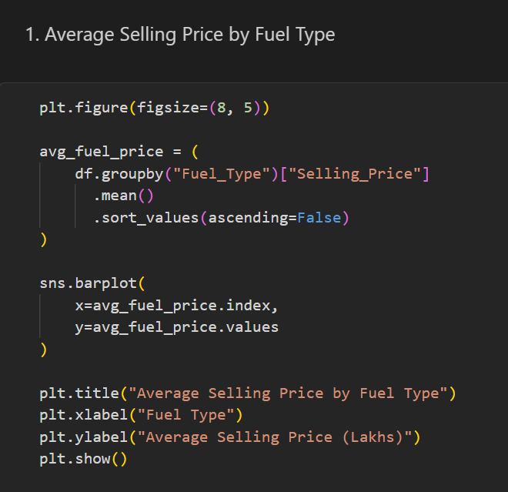
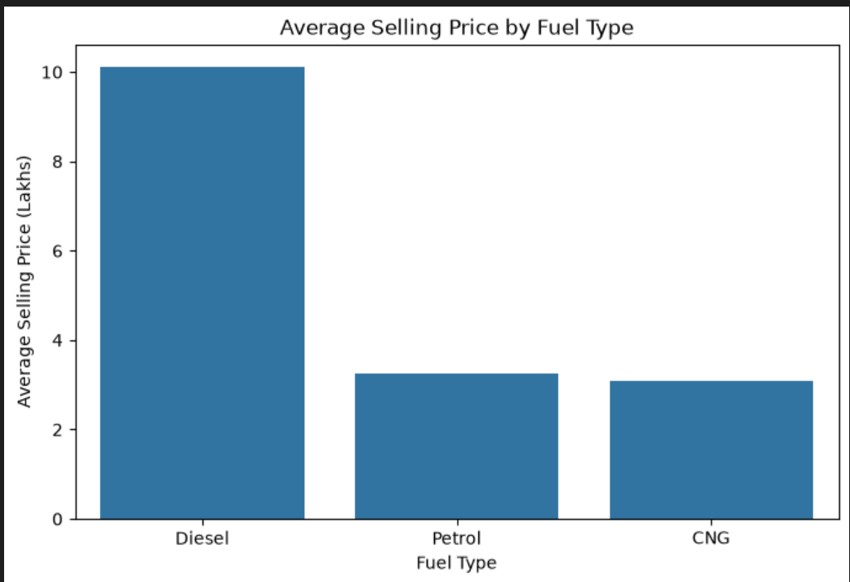
RESULTS
INSIGHT : Diesel cars generally command higher average selling prices than Petrol and CNG cars in the dataset.
https://github.com/relhan-pinki/Car-Market-Analysis

Slide 7
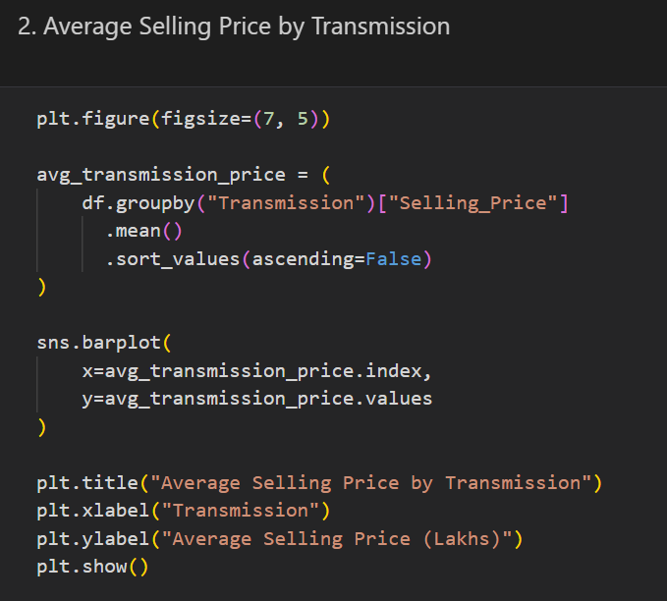
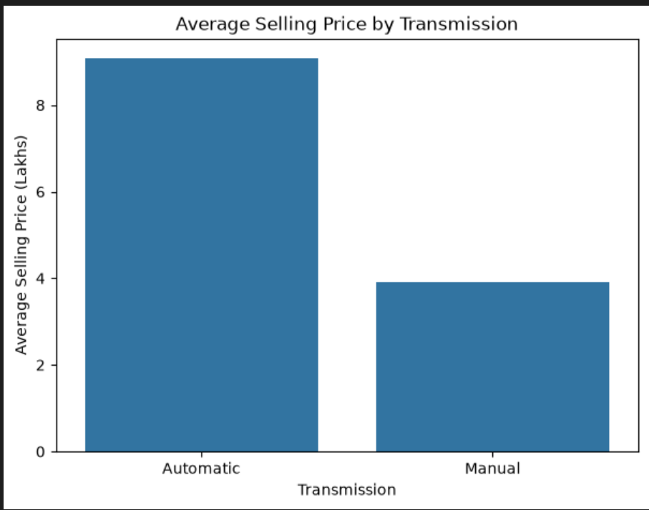
RESULTS
INSIGHT : Automatic cars have a higher average selling price than Manual cars, indicating greater resale value for automatic vehicles..
https://github.com/relhan-pinki/Car-Market-Analysis

Slide 8
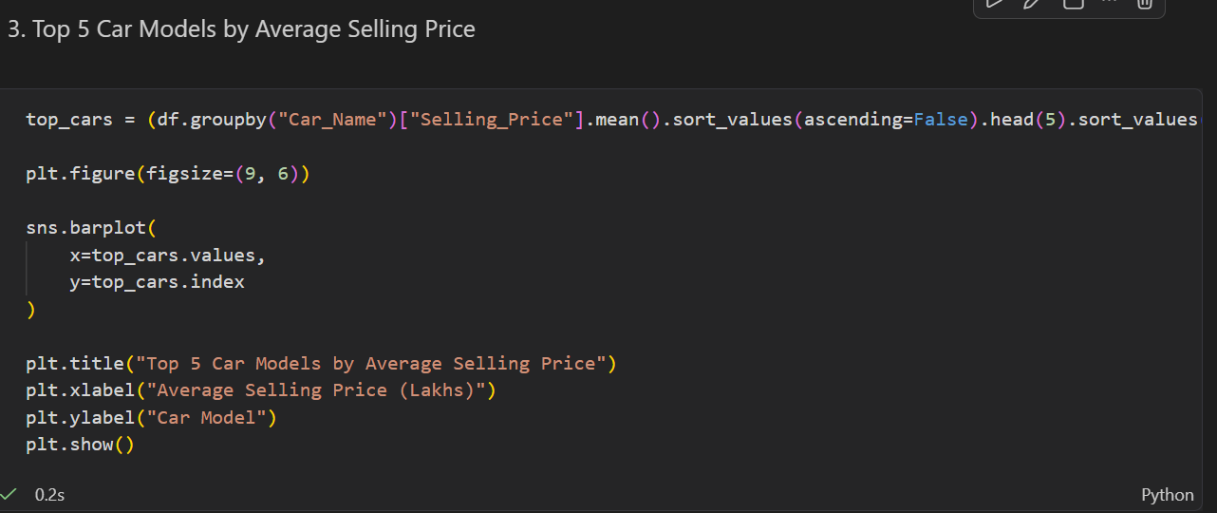
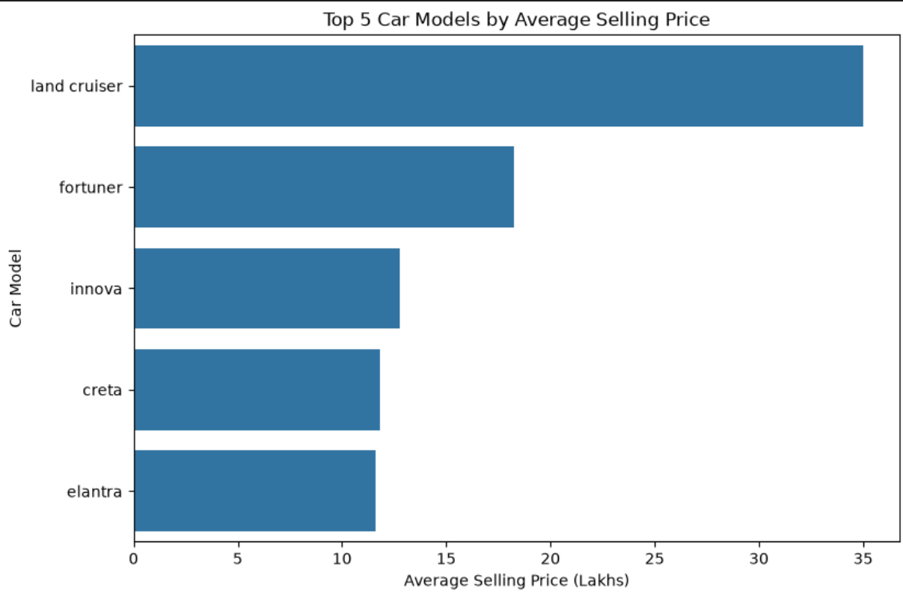
RESULTS
INSIGHT : Land Cruiser and Fortuner are among the highest-priced repeatedly listed models
https://github.com/relhan-pinki/Car-Market-Analysis

Slide 9
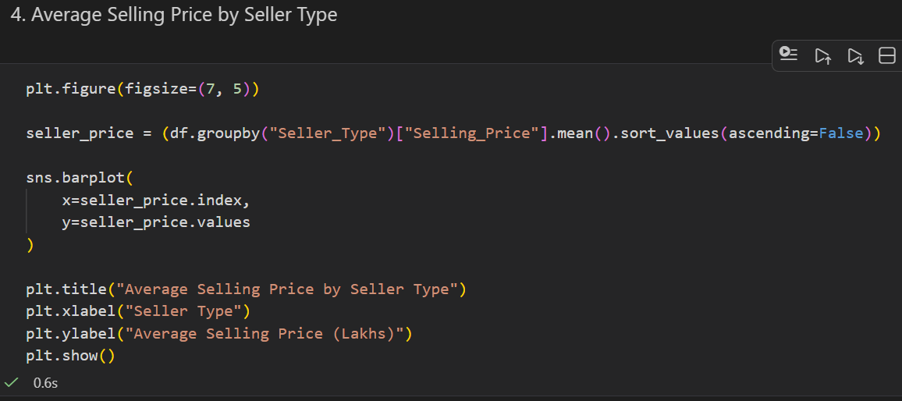
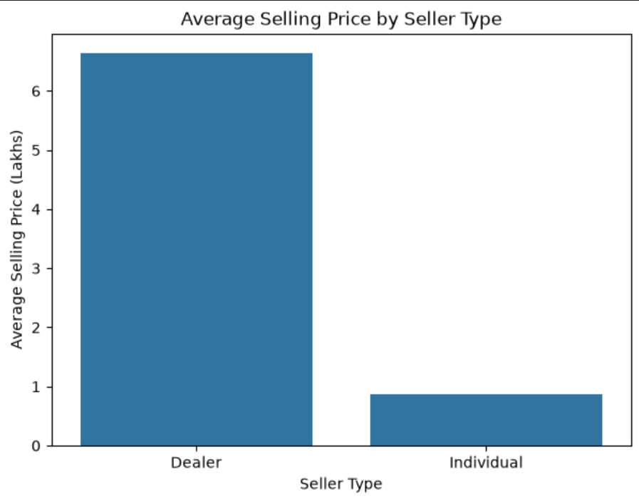
RESULTS
INSIGHT : Dealer car have higher average selling price than individual
https://github.com/relhan-pinki/Car-Market-Analysis

Slide 10
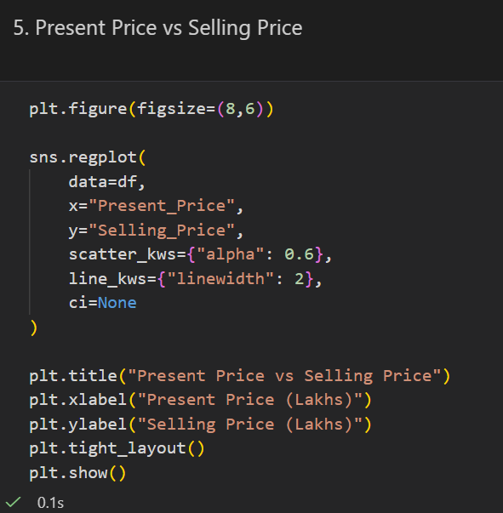
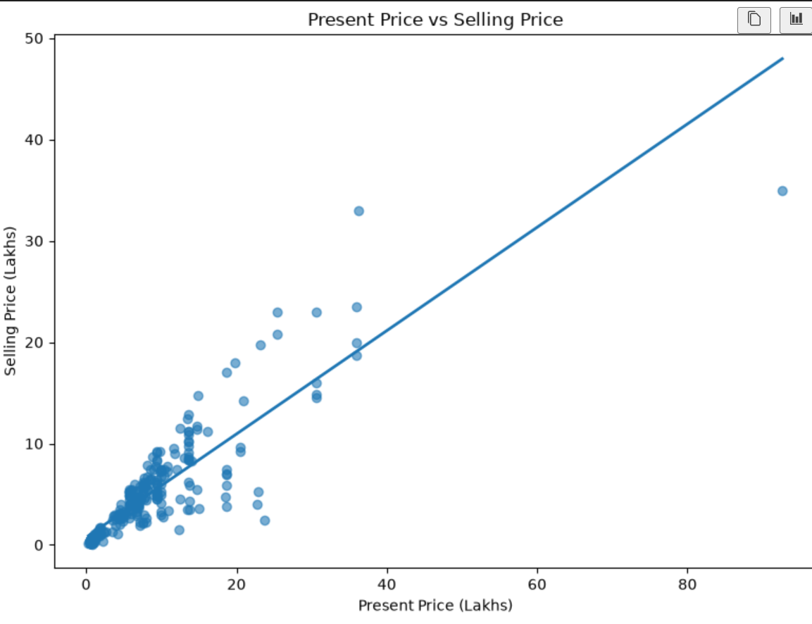
RESULTS
INSIGHT : Present price shows a strong positive relationship with selling price, meaning higher-priced cars generally have higher resale values.
https://github.com/relhan-pinki/Car-Market-Analysis

Slide 11
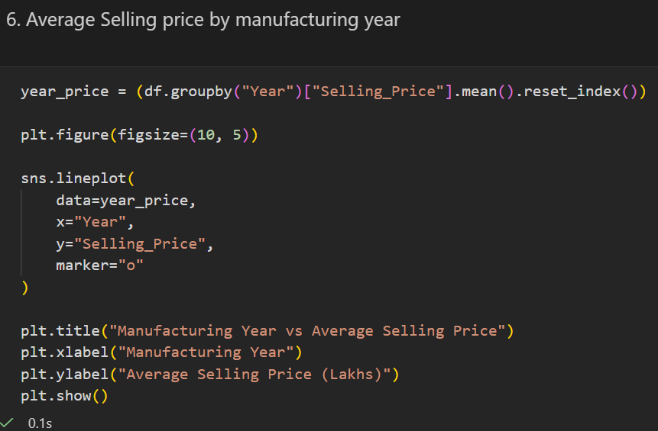
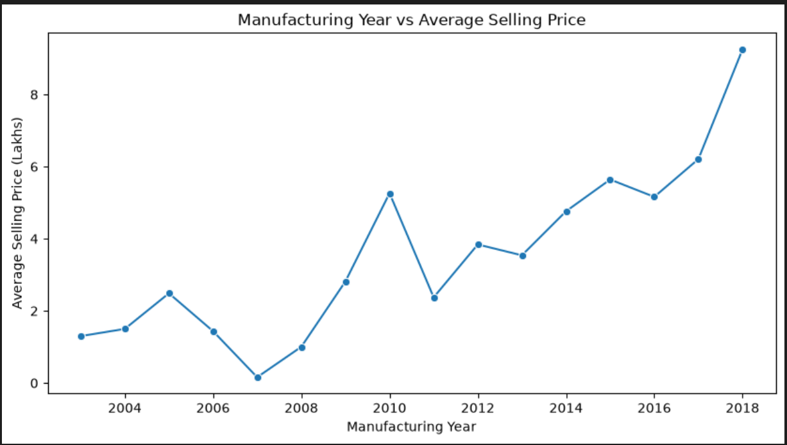
RESULTS
INSIGHT : Newer cars generally have higher average selling prices, while older vehicles tend to have lower resale values.
https://github.com/relhan-pinki/Car-Market-Analysis

Slide 12
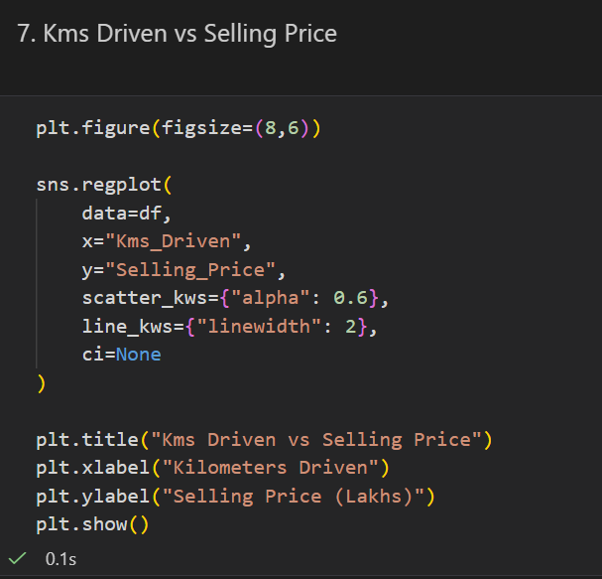
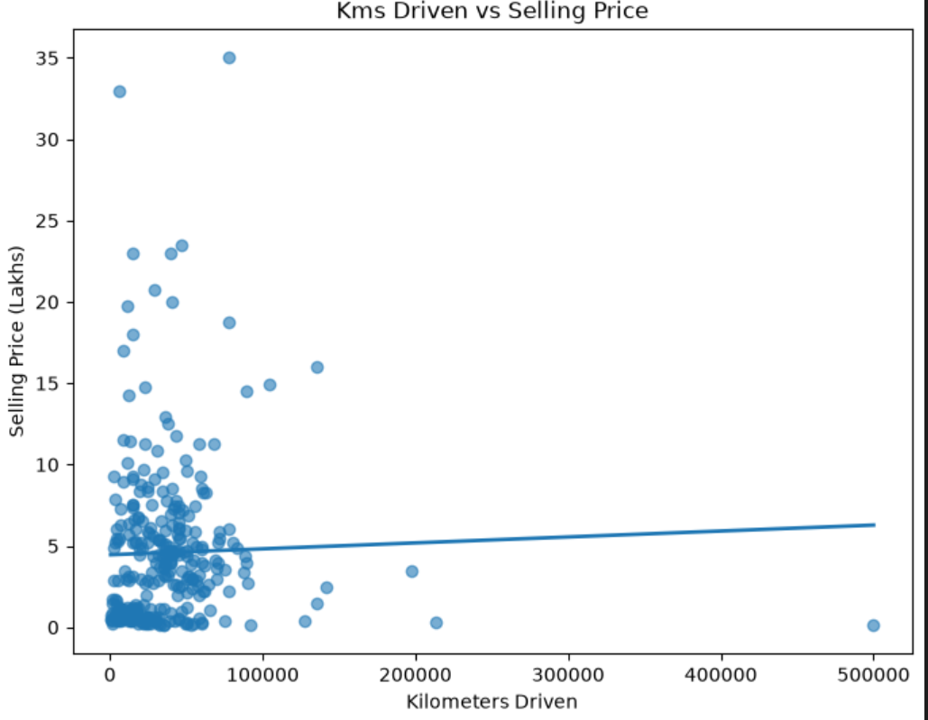
RESULTS
INSIGHT : Kilometers driven shows a weak relationship with selling price, indicating that mileage alone does not strongly determine resale value.
https://github.com/relhan-pinki/Car-Market-Analysis

Slide 13
Thank you
GitHub link : https://github.com/relhan-pinki/Car-Market-Analysis
.
.

